Slide 1
BreathaLock Critical Design Review Breathalyzer Integrated Onto A Key fob
Group #31
Nicholas Fraser, Electrical Engineer
Nam Ngo, Electrical Engineer
Charles Taylor, Computer Engineer

Slide 2
Motivation
About 1,825 college students between the ages of 18 and 24 die from alcohol-related unintentional injuries, including motor vehicle crashes.
Mitigate drunk driving by adding barriers and alternatives
The Alaska DMV estimates that over 5 years, a DUI costs the convicted driver almost $25,000, and Tennessee estimates that figure at between $5,000 and $10,000.
Being in “physical control” (essentially inside the car, not driving) of the vehicle can still result in a DUI charge

Slide 3
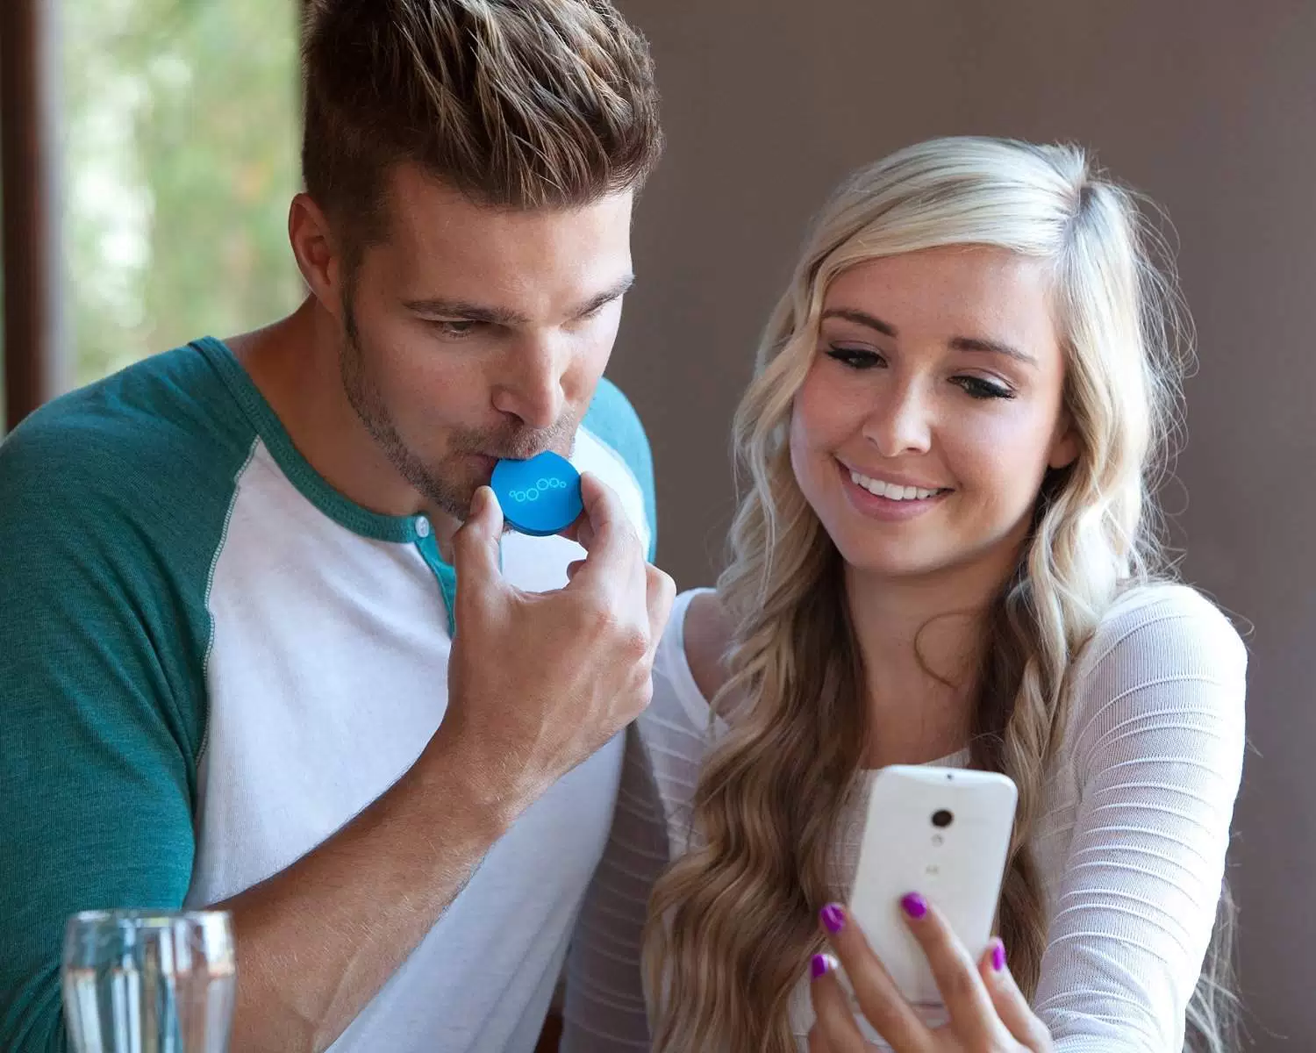
Goals and Objectives
Mitigate drunk driving for vehicle owners
Provide a inexpensive barrier for users that frequently drunk drive
Build a breathalyzer that links to phone via Bluetooth
Upon a satisfactory alcohol limit trigger the unlock
Create a device small enough to not be cumbersome
Provide a civic service to our peers

Slide 4
Specifications and Requirements
Size | 3” x 3” x 7”
Weight | less than a pound
Power | within 20V
System | Both sensors must operate with a delay of less than 10 seconds. When a lock signal is sent, the automotive should be locked. When a blood alcohol content is at .08 or above, the device must not be able to transmit an unlock signal. The device must be able to store the fingerprint data of registered user.

Slide 5
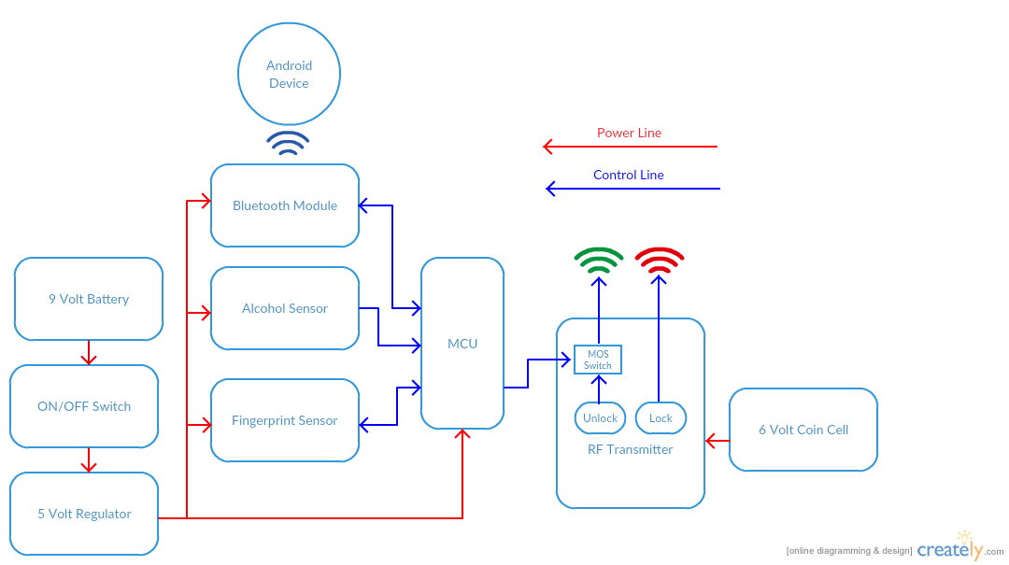
Overall Block Diagram

Slide 6
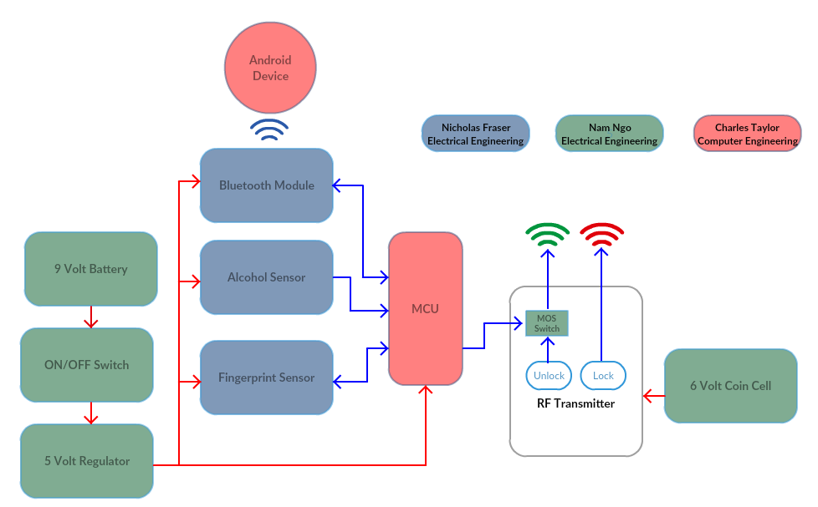
Work Distribution Diagram

Slide 7
Sensor Workflows

Slide 8
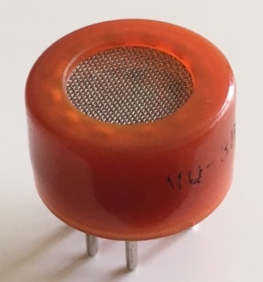
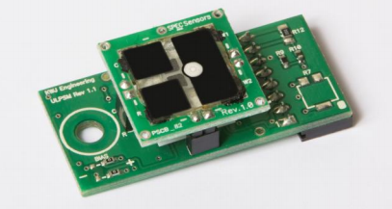
Alcohol Sensor Options
Component | MQ-3 | SPEC ULPSM-Ethanol 968-007
Cost | $4.95 | $50.00
Read Data | Analog | Analog Voltage
Voltage Required | 5v | 3v
Product Support | Low | High
Deciding Factor: | MQ-3 for overall product cost

Slide 9
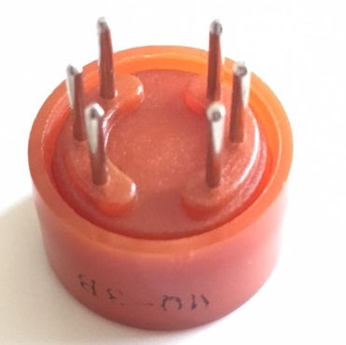
Alcohol Sensor Characteristics
Component | MQ-3
Sensor Type | Semiconductor
Target Gas Type | Alcohol
Detection Range | 25-500ppm alcohol
Heater Voltage | 5.0V
Output Voltage | 2.5-4.0V
Notes:
We chose to use the MQ-3 alcohol sensor because of its simplicity, sensitivity, and fast response time. This sensor provides an analog output that can be read and analyzed by a microcontroller to decipher the sobriety of the user.

Slide 10
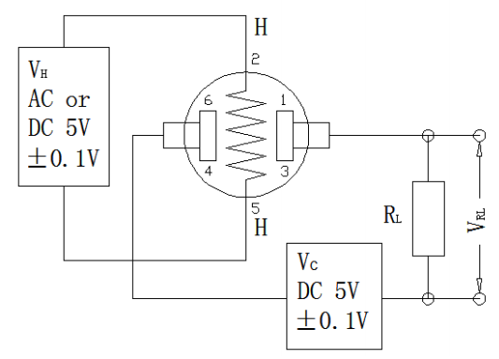
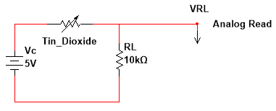
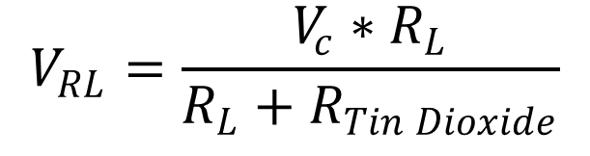
Alcohol Sensor Subsystem
The MQ-3 sensor operates by heating a piece of tin dioxide and passing current through it.
Tin dioxide’s conductive properties change in the presence of alcohol.
Using the effect of a voltage divider we can read the voltage across a load resistor and relate that to alcohol presence.
Notes:
The MQ-3 sensor operates by heating a piece of tin dioxide and passing current through it. Tin dioxide’s conductive properties change in the presence of alcohol.
Using the effect of a voltage divider we can read the voltage across a load resistor and relate that to alcohol presence.

Slide 11
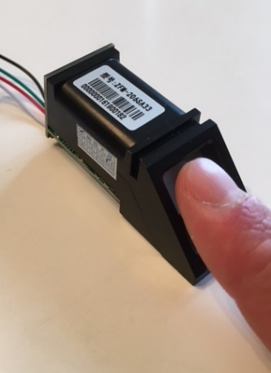
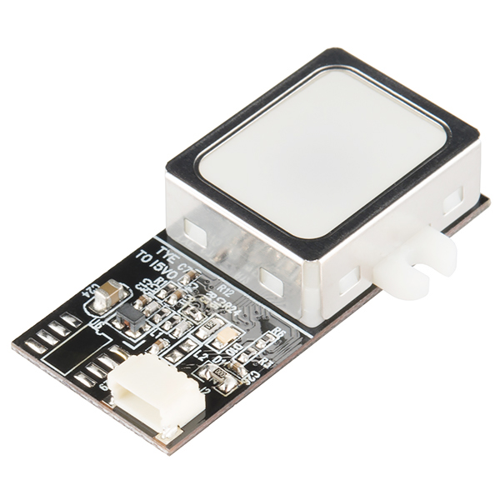
Fingerprint Sensor Options
Name | ZFM-20 (Adafruit) Series Fingerprint Sensor | GT-511C3
Cost | $49.95 | $31.95
Baud Rate | 9600-57600 | 9600
Voltage Required | 3.6-6v | 3.3-6v
Required Pins | Vcc, GND, Tx, Rx | Vcc, GND, Tx, Rx
Product Support | High | Some
Deciding Factor | Product support and the ZFM-20 is more modular and size effective.

Slide 12
Fingerprint Sensor Characteristics
Component | Fingerprint Sensor
Supply voltage | 3.6-6.0VDC
Operating Current | 120mA max
Peak Current | 120mA
Imaging time | Less than 1 second
Interface | TTL Serial
Dimension | 56 x 20 x 21.5mm
Weight | 20 grams
Modes | Enrolling, Searching and Deleting

Slide 13
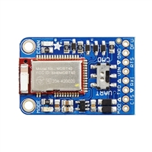
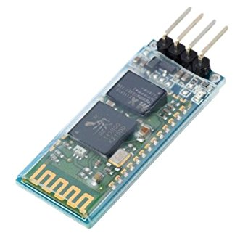
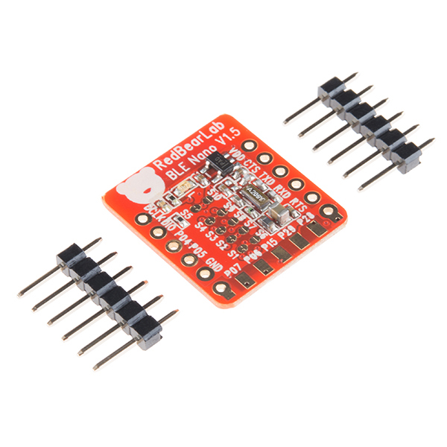
Bluetooth Module Options
 | Bluefruit LE UART Friend | Phantom YoYo JY-MCU Bluetooth | BLE Nano –nRF51822
Cost | $17.50 | $11.99 | $24.95
Power Consumption | Low | Moderate | Low
Compatibility | IOS/Andriod | IOS/Andriod | IOS/Andriod
Technical Support | High | Low | High
Deciding Factor | Price and product support
Notes:
Deciding Factor: price and product support

Slide 14
Bluefruit LE UART Friend
Onboard Processing | ARM Cortex 16Mhz
Flash Memory | 256KB
RAM | 32KB SRAM
Baud Rate | UART at 9600 Baud
Supply Voltage | 5v-safe input with onboard voltage regulation
Dimensions | 21 x 32 x 5mm
Weight | 3.4g

Slide 15
Power System

Slide 16

Power options
Main PCB (9V)
 | Pros | Cons
9V Standard | Compact Long shelf life Light Weight | Awkward dimension
6 x 1.5V AA | High energy density | Heavy Not compact
3 x 3V coin cell | Ultra-compact Light weight | Low energy density
Transmitter(6V)
 | Pros | Cons
2 x 3V Coin-cell | Ultra compact Shelf life | Low energy density
4 x 1.5AA | High energy density | Heavy Not compact

Slide 17
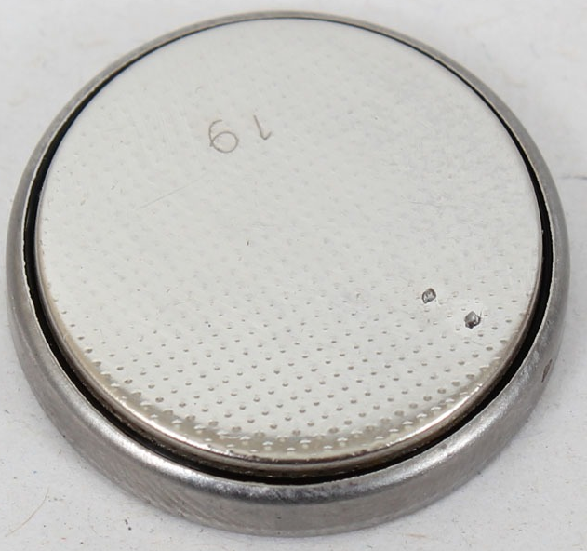

Battery Selection
Main PCB:
Standard 9V battery
Lithium ion, Lithium polymer, nickel-metal hydride
Rechargeable, nonrechargable
RF transmitter:
2x 3V coin-cell
Lithium ion

Slide 18
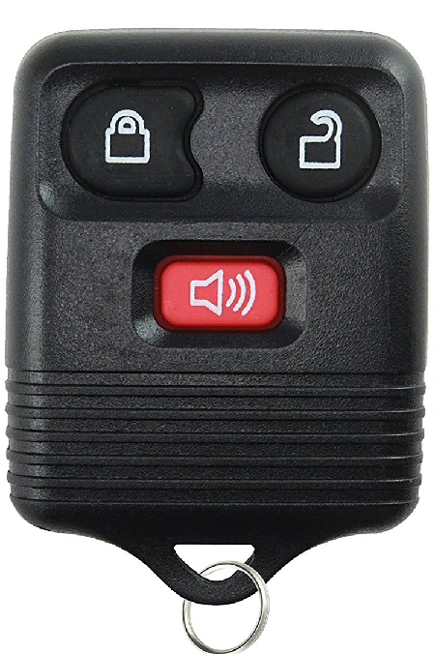
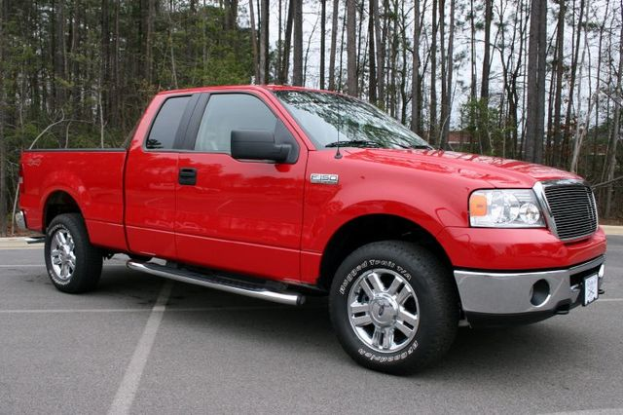
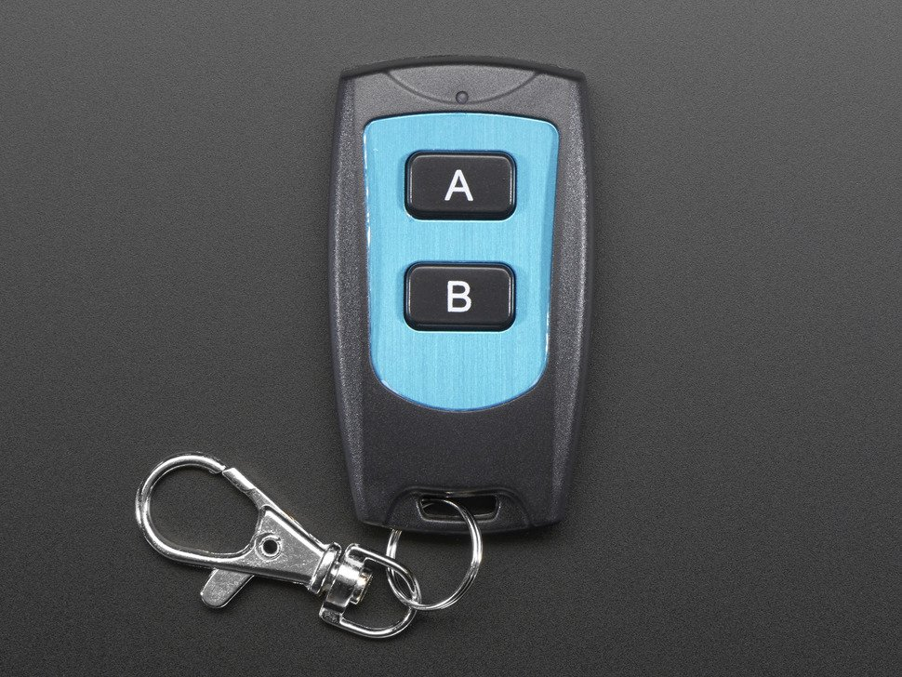
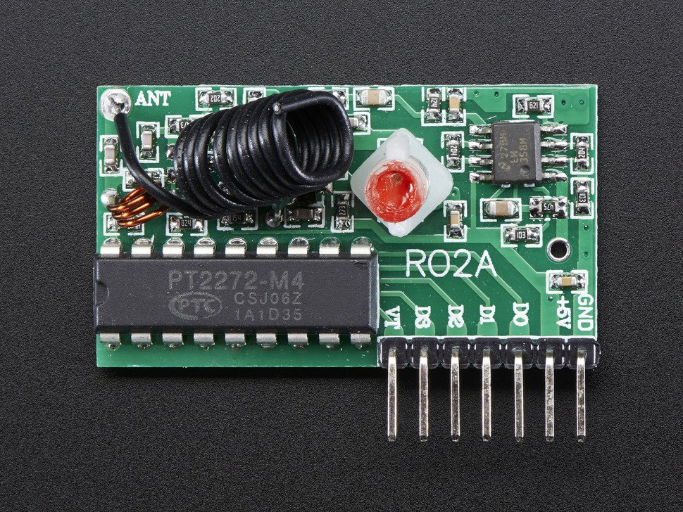
RF transmitter, RF receiver
Previous transmitter and receiver
Current transmitter and receiver

Slide 19
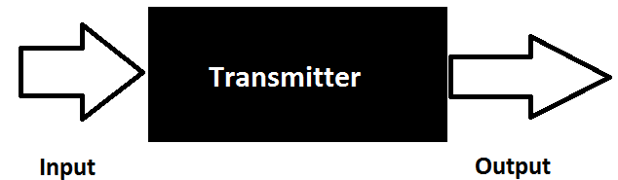
Modeling RF transmitter
Knowns:
Device output given device input
Operating voltage of 4-6V
RF transmitter component
LED status given an input
Unknowns:
Circuit schematic

Slide 20
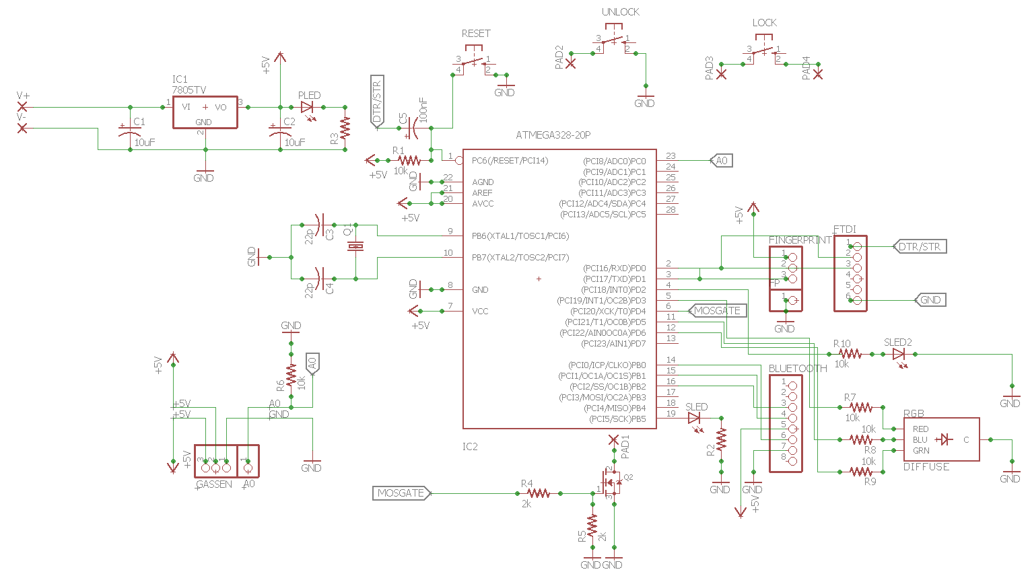
Overall PCB Schematic

Slide 21
Power PCB Schematic
Regulated Power Supply

Slide 22
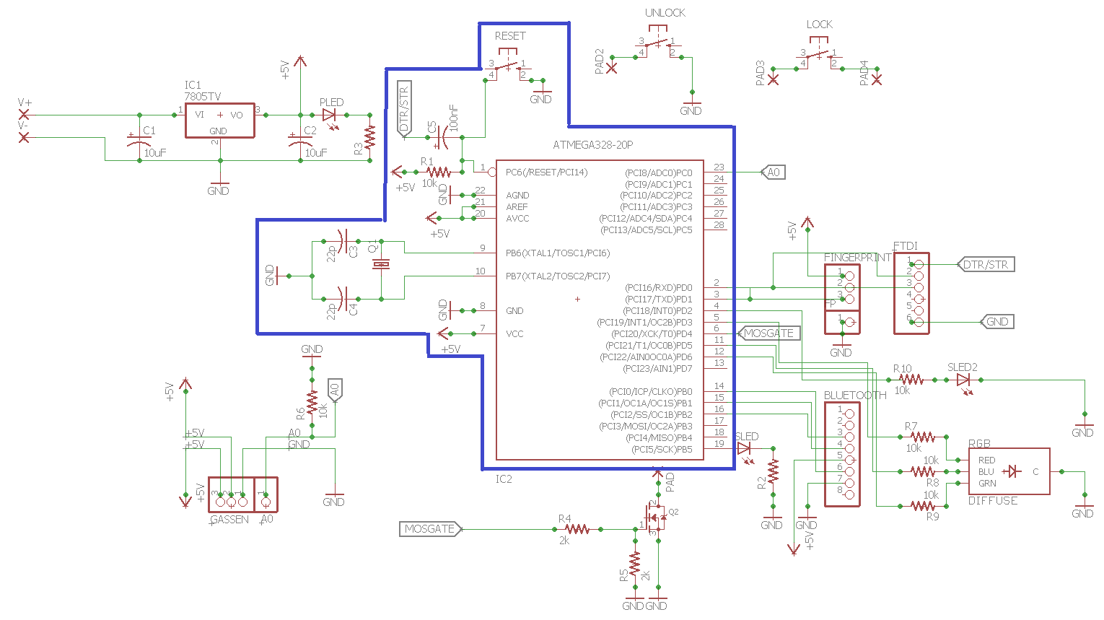
Microcontroller PCB schematic
Microcontroller

Slide 23
PCB Transmitter integration Schematic
Unlock Lock Pushbutton
MOSFET
Mosfet switch

Slide 24
PCB sensor Integration Schematic
Fingerprint Sensor
Alcohol Sensor
Bluetooth Module

Slide 25
PCB Status LED Integration Schematic
Status LEDs

Slide 26
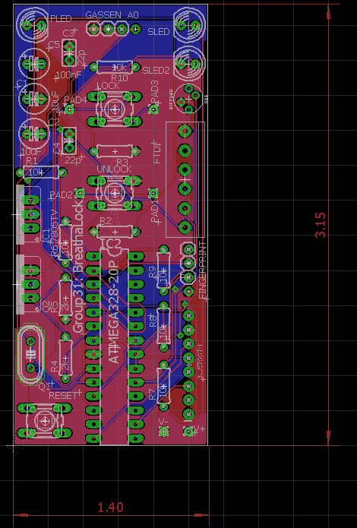
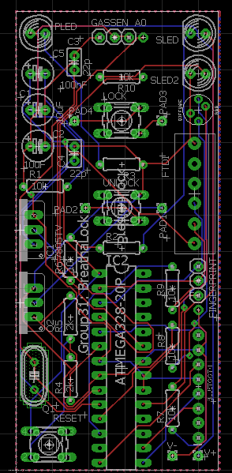
PCB Eagle Board Layout
Notes:
NAM can you add words to fill up white space

Slide 27
Software & MCU

Slide 28
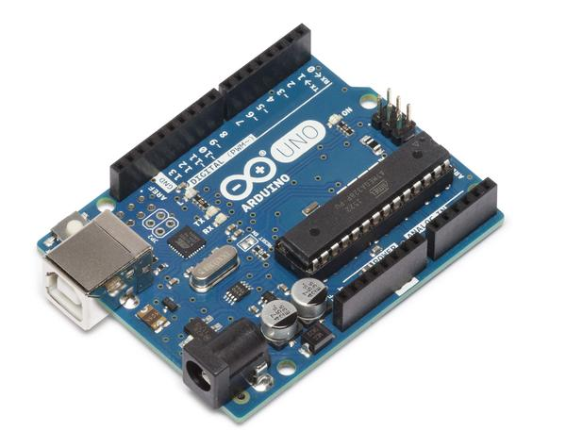
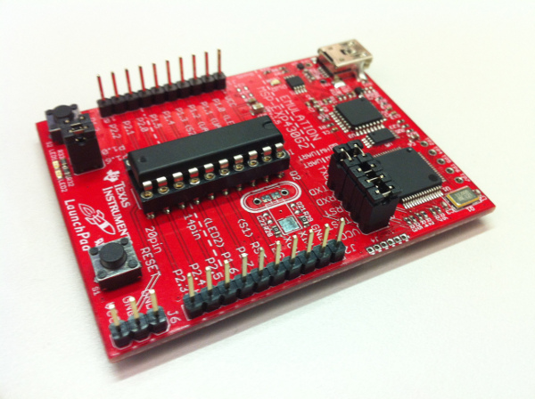
Microcontroller Development Environment
 | Arduino | MSP430
Pros | Well documented Easy to use Removable microcontroller User friendly Group was very familiar | Low power Removable microcontroller Fast Performance
Cons | Slow performance | Moderate Understanding
Deciding Factor | Based on experience, user documentation, and user friendliness we went with the Arduino for development purposes

Slide 29
Project Microcontroller
 | ATmega328p | MSP430G2212IN20
CPU speed | 16MHz | 16MHz
Program Memory Size | 32KB | 2KB
RAM Memory Size | 2KB | 256 Byte
Operating voltage | 5V | 1.8V-3.6V
Number of I/O | 26 | 16
Cost | $2.18 | $1.65
Experience | High | Moderate
Documentation | Great | Moderate

Slide 30

Android vs. IPhone
 | Android | Apple iOS
Cost | Free | $99/yr + $500+ (Computer)
Software Experience | High | Low
User Engagement | ~52% of the market | ~37% of the market
Technical Support | High | High

Slide 31
Software Flow

Slide 32
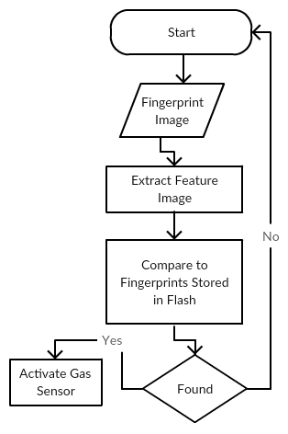
Fingerprint Process Flow
After powering Breathalock on before proceeding the user must
Have a fingerprint stored
Scan your finger
The user will place their finger on the scanner
The scanner takes roughly 2 seconds to scan
The device then compares that image to

Slide 33
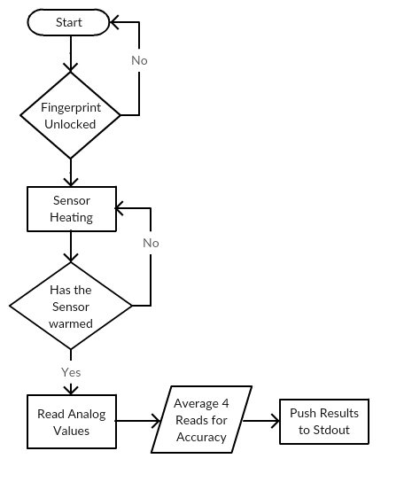
Gas Sensor Software Flow
Before processing Alcohol content in air the user must
Unlock the device with the fingerprint sensor
Wait for warming time
The device will begin reading the analog values passed over the sensor
To mitigate abnormal readings we average four readings together
Push the results to standard out

Slide 34
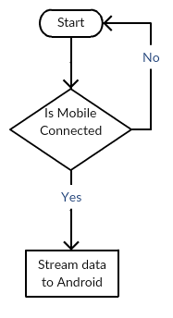
Bluetooth Software Flow
When the device is enabled it should be checking for mobile connection
If connected begin streaming data to the Android app

Slide 35
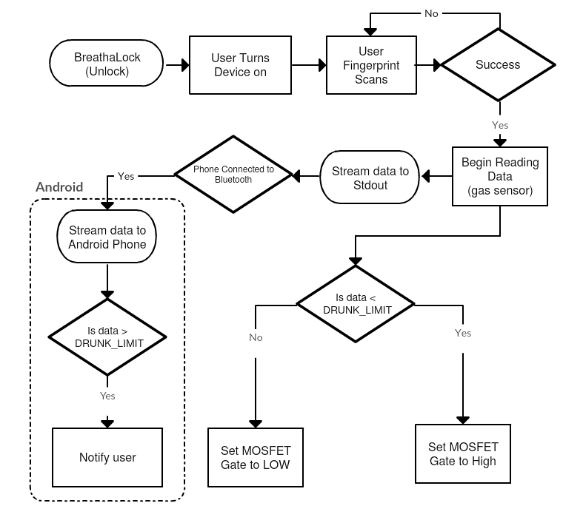
Total Process Flow

Slide 36
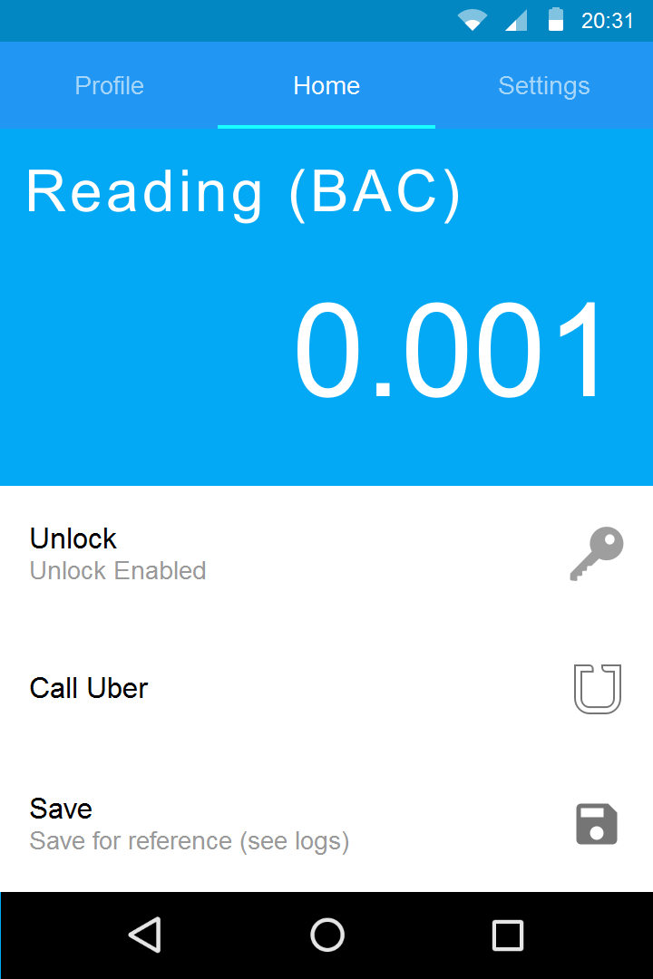
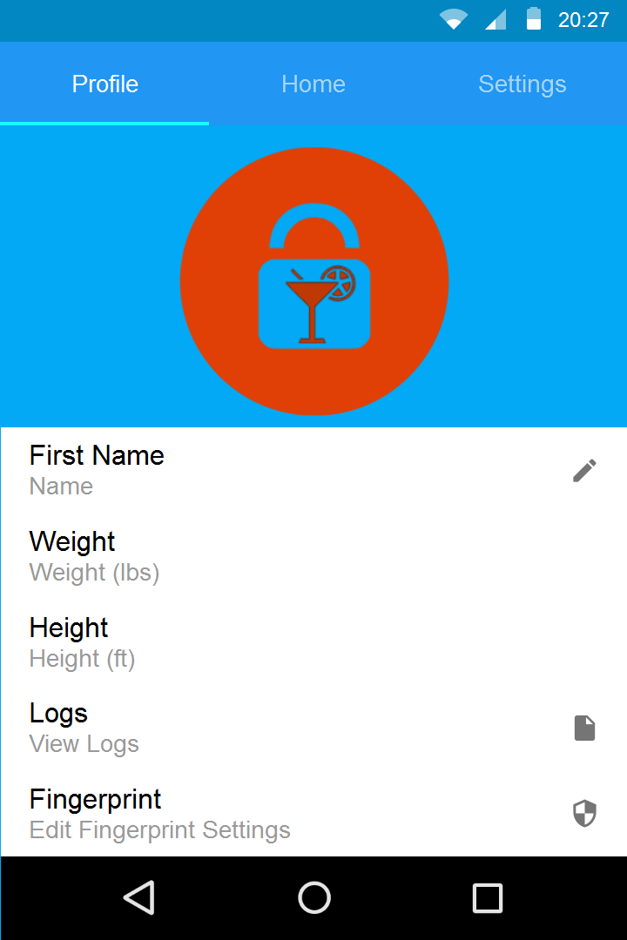
Android App Features
Main Screen
BAC / PPM
Lock Status
Call Uber
Record data
Profile
Avatar Picture
Name
Height/Weight
View Logs
Modify Fingerprint

Slide 37
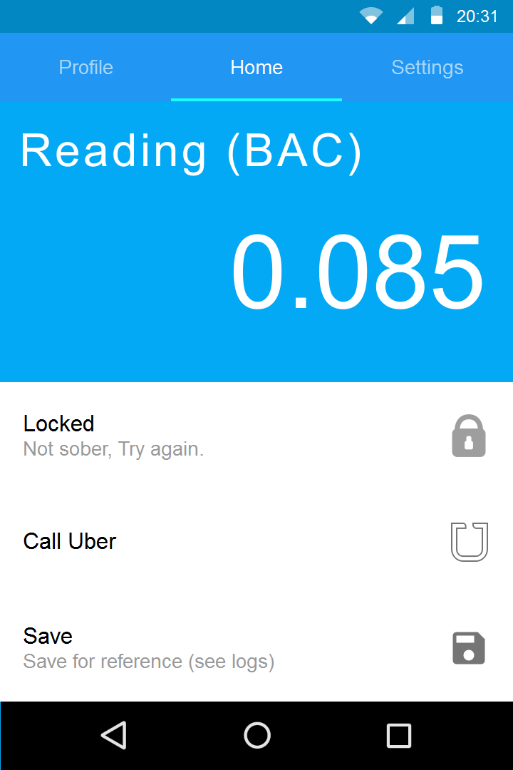
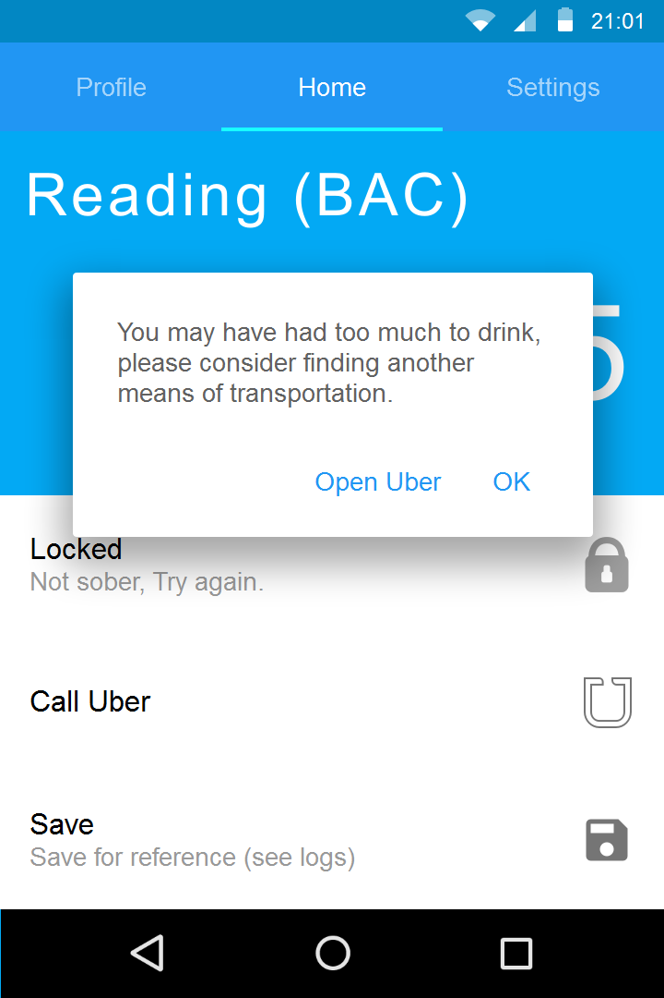
Procedure
Uber option always available
When measuring over the limit the unlock button becomes unavailable on the device
You are prompted with an alert which includes
Ok - returns to menu
Open Uber - this will open the uber app

Slide 38
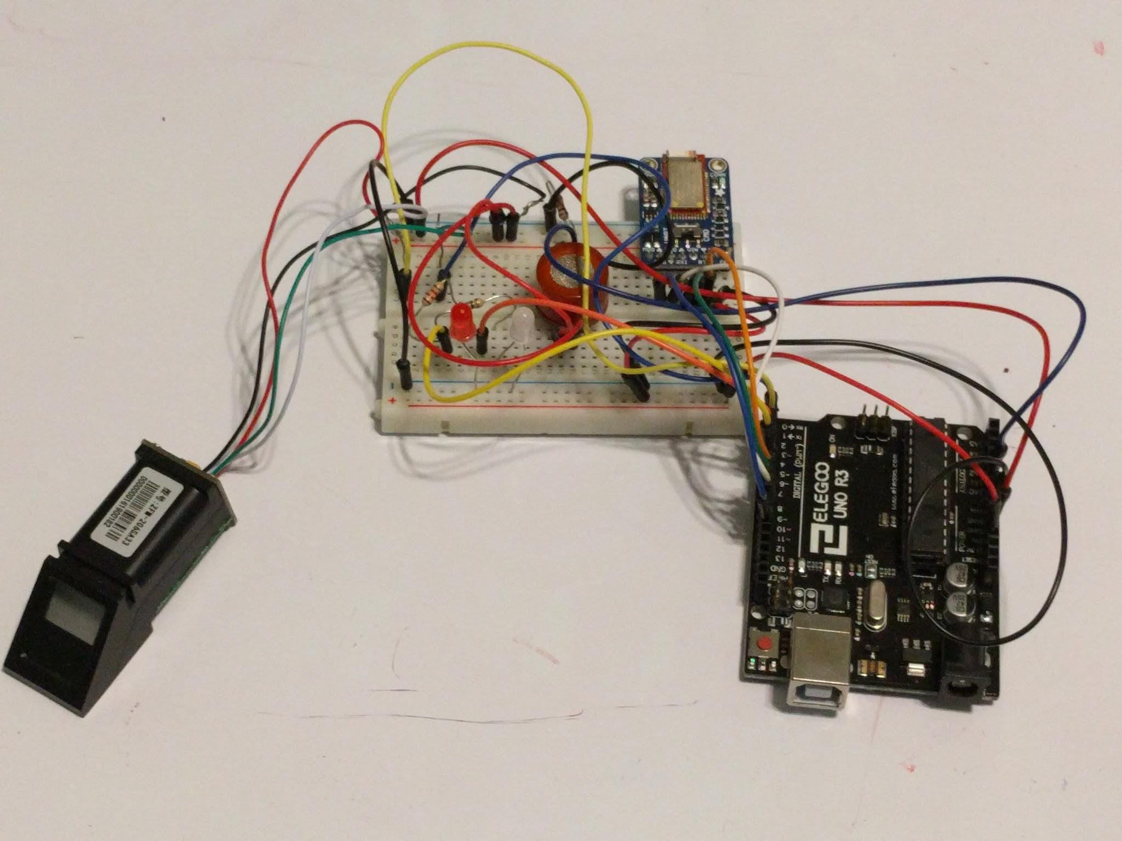
Prototyping
Pictured Development Board (left to right):
Fingerprint Sensor
Alcohol Sensor (MQ-3)
Bluetooth
Development Board

Slide 39
Administrative Content

Slide 40
Work Distribution
Name | Power | Component Testing | PCB Schematic | PCB Board Layout | Software | Mobile Application
Nick | Secondary | Primary | Primary | Secondary | Secondary
Charles |  | Secondary |  |  | Primary | Primary
Nam | Primary |  | Secondary | Primary |  | Secondary

Slide 41
Budget Analysis
Estimated Cost
Part | Quantity | Cost | Total
Microcontroller | 2 | $10-$20 | $20-$40
Fingerprint Sensor | 2 | $30-$45 | $60-$90
Bluetooth Module | 2 | $20-$35 | $40-$50
Blood alcohol Sensor | 2 | $30-$45 | $60-$90
Battery | 6 | $3-$5 | $6-$10
Remote Key | 2 | $20-$30 | $40-$60
PCB | 3 | $20-$30 | $60-$90
Estimated Grand Total |  |  | $376-$430
Actual Costs
Part | Quantity | Cost | Total
Microcontroller | 1(3 pieces) | $15 | $15
Fingerprint Sensor | 1 | $50 | $50
Bluetooth Module | 1 | $20 | $20
Gas sensor | 2 | $5 | $10
RF transmitter | 3 | $7 | $21
RF receiver | 1 | $5 | $5
FTDI board | 1 | $8 | $8
Crystal Oscillators | 1(10 pieces) | $6 | $6
N-channel MOSFET | 1(7 pieces) | $7 | $7
Dip Socket | 1(10 pieces) | $7 | $7
Total |  |  | $149
Notes:
Estimated, bought multiple components, and does not include PCB yet

Slide 42
Cost Analysis (per item)

Slide 43
Financing
No sponsorship
We are self-funded and have no sponsorships therefore, are able to create the product to our own preferences with no constraints.
We have to pay for everything ourselves.

Slide 44
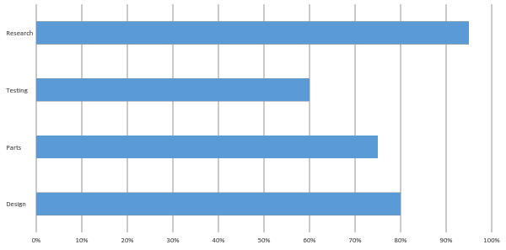
Progress

Slide 45

Concerns and Issues
Gas sensor calibration: “0.4mg/L
Correlation
New sensor: ULPSM-Ethonol 968-007
Project enclosure
PCB connections
System optimization

Slide 46
Questions?

